Slide 1
Name : Salman A
NM.ID : au730321243022
RegNo : 730321243022
Dept : B.Tech AI and DS
Year : III-rd year
College : Builders Engineering College

Slide 2
Image Generation using GAN
Generative Adversarial Networks (GANs) have emerged as a powerful framework for generating realistic data samples across various domains, from images and text to music and video. This project aims to explore and harness the capabilities of GANs for various creative and practical applications.

Slide 3


AGENDA
Introduction and Overview
Background Research
Theory and Fundamentals
Implementation and Experimentation
Evaluation and Validation
Applications and Use Cases
Optimization and Performance Tuning
Documentation and Reporting
Future Directions and Collaboration
Conclusion
3/21/2024 Annual Review

Slide 4

PROBLEM STATEMENT
The objective of this project is to address key challenges and limitations in the development and application of Generative Adversarial Networks (GANs), focusing on improving training stability, enhancing data generation quality, and exploring practical applications across different domains.
Key Challenges
Training Stability
Data Generation Quality
Mode Collapse
Evaluation Metrics
Ethical Considerations

Slide 5

PROJECT OVERVIEW
The GAN (Generative Adversarial Networks) project aims to explore and harness the capabilities of GANs in generating synthetic data samples across various domains. GANs have revolutionized the field of artificial intelligence by enabling the creation of data that closely resembles real data distributions. This project seeks to delve into the theoretical foundations, practical implementations, and real-world applications of GANs to address key challenges and unlock their potential for creative expression, data augmentation, and anomaly detection.
Objectives:
Understanding GAN Fundamentals
Implementation and Experimentation
Evaluation and Validation
Applications and Use Cases
Optimization and Performance Tuning
Documentation and Reporting

Slide 6

WHO ARE THE END USERS?
The end users of the GAN (Generative Adversarial Networks) project can vary depending on the specific applications and use cases explored within the project. Here are some potential end users for different aspects of the GAN project:
Researchers and Academics
Data Scientists and Machine Learning Engineers
Creative Professionals
Developers and Technologists
Regulatory Bodies and Policy Makers

Slide 7

SOLUTION AND ITS VALUE PROPOSITION
The GAN (Generative Adversarial Networks) project aims to develop advanced generative models capable of creating realistic and diverse data samples across various domains, including images, text, and music. Leveraging state-of-the-art deep learning techniques, the project will explore novel GAN architectures, optimization strategies, and practical applications to address key challenges and unlock the full potential of generative modeling technology.
Some key components:
1.Model Architecture Design
2.Model Interpretability and Visualization
3.Deployment and Integration
Value Proposition:
Data Augmentation and Synthesis
Practical Applications in Industry
User Experience Enhancement
Ethical and Responsible Use

Slide 8

THE WOW FACTORS:
Generative Adversarial Networks (GANs) are influenced by several factors that impact their performance, training stability, and effectiveness in generating realistic data samples.
Architecture
Loss Function
Hyperparameters
Training Strategies
Dataset Quality and Size
Regularization Techniques
Initialization and Optimization
Evaluation Metrics
3/21/20

Slide 9
MODELLING
Generator: Creates new data (like images or text) from scratch.
Discriminator: Acts like a critic, trying to determine if data is real or generated.
The Adversarial Process:
In an iterative training process, the generator and discriminator play an adversarial game:
The generator continuously improves its ability to create realistic forgeries.
The discriminator hones its skills to effectively distinguish real data from generated data.
Training Loop:
The generator creates new data instances.
The discriminator receives both real data (from the training set) and the generated data.
The discriminator tries to classify each data instance as real or fake.
Based on the discriminator's feedback, the generator is fine-tuned to improve the realism of its creations.

Slide 10
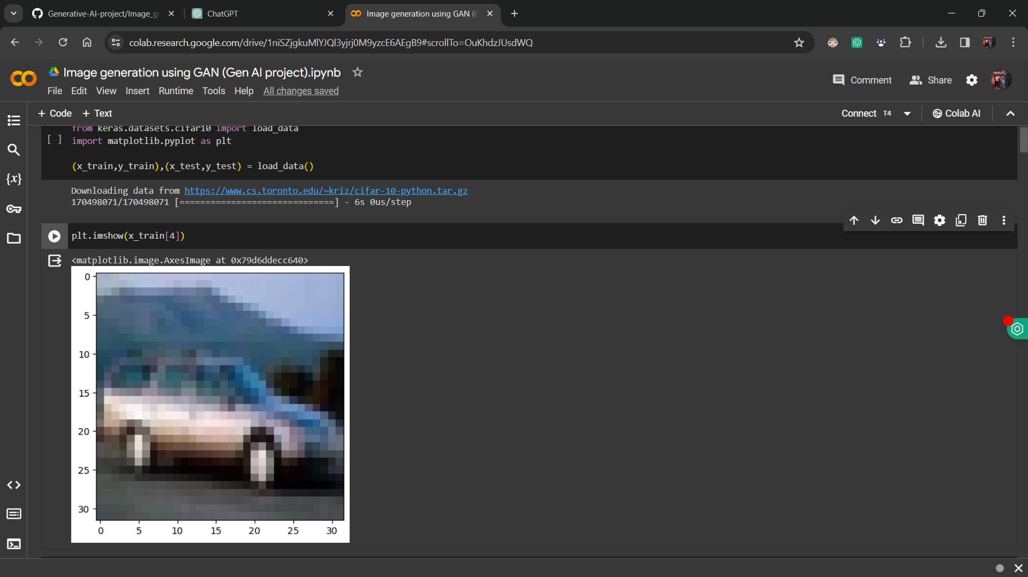
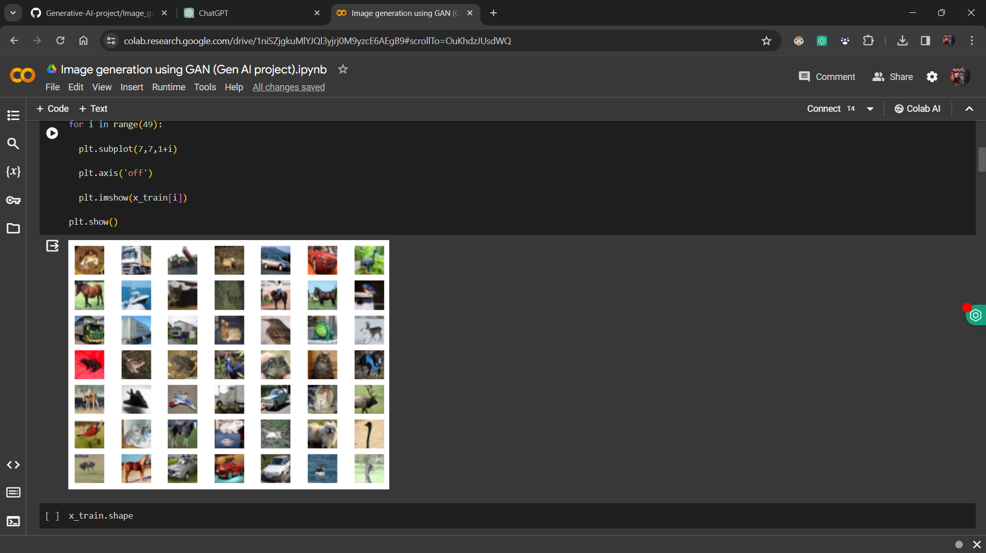
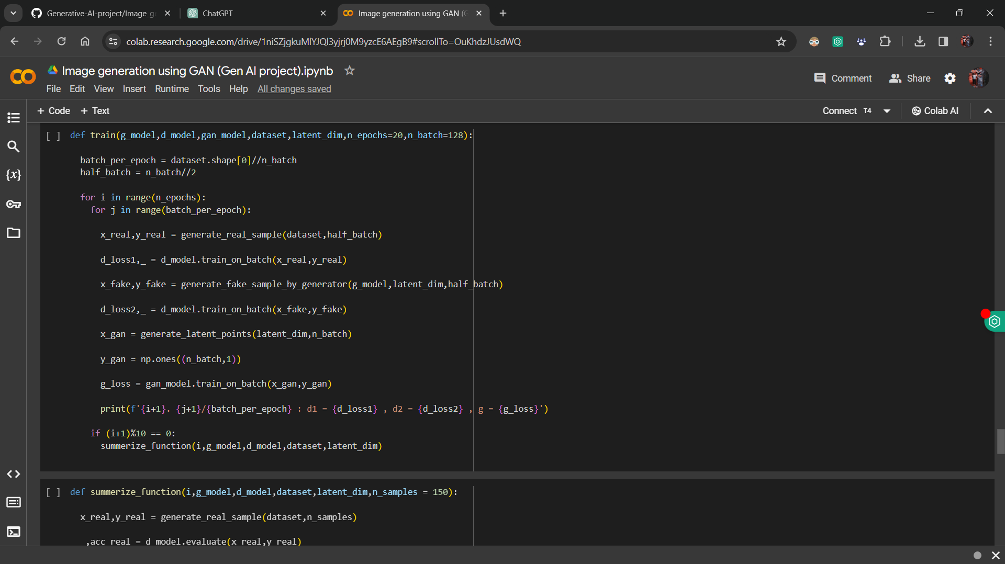
RESULTS
Github Link

